Slide 1
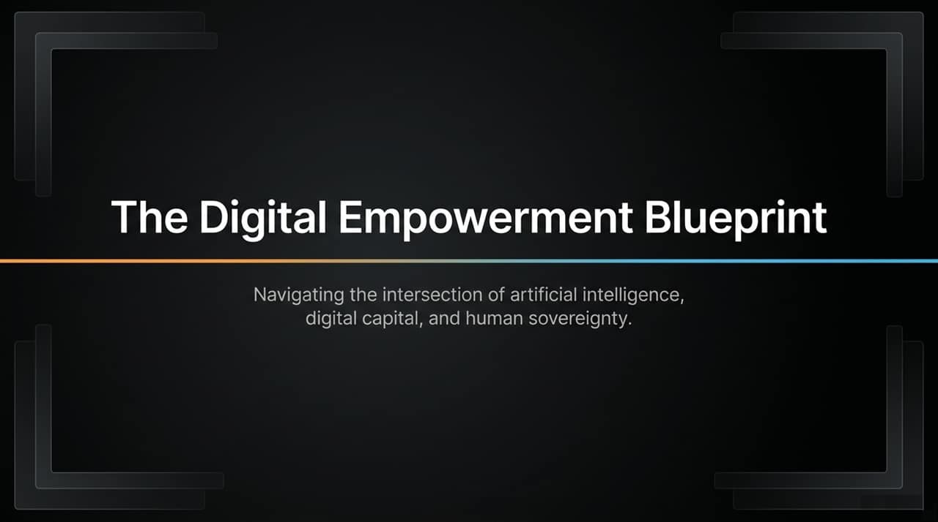
Notes:
Welcome, everyone. Today, we are exploring a paradigm shift—a grand unification of three powerful forces shaping our decade: Artificial Intelligence, Digital Capital, and Human Sovereignty.
We stand at a unique crossroads in history. On one hand, artificial intelligence is transforming how we produce work, generate content, and process information at near-zero marginal cost. On the other hand, the financial architectures of the past century are rapidly melting beneath our feet. To navigate this intersection, we need more than just tactical adjustments; we need a complete framework for personal and institutional empowerment.
In this presentation, we will dismantle legacy financial assumptions, evaluate the true nature of digital scarcity, explore how to leverage AI without being commoditized by it, and lay out an internal and external operational system for individual sovereignty in an automated age.
https://www.youtube.com/watch?v=1aGpJQ8BMLI

Slide 2
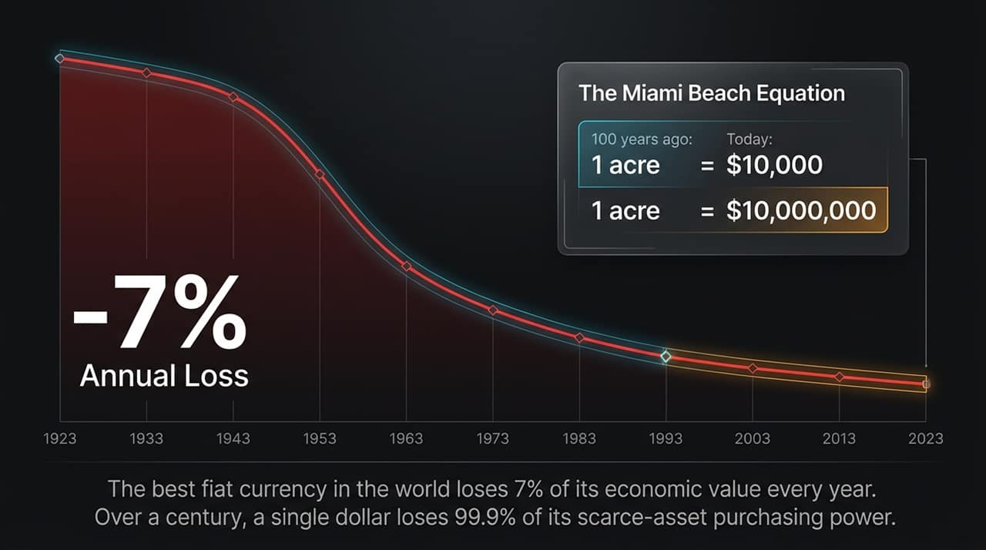
Notes:
Let’s start by diagnosing the foundational flaw of traditional money.
Look at the Miami Beach Equation on the right side of this slide. A hundred years ago, a single acre of pristine Miami Beach real estate cost around $10,000. Today, that same acre costs upward of $10,000,000. Did the land become 1,000 times more valuable, or did the purchasing power of the fiat currency collapse by 99.9%?
When you analyze fiat currency—even the absolute best reserve currency on earth, the U.S. Dollar—it suffers from a constant, compounding decay rate of roughly -7% per year in terms of scarce, desirable assets. Most people think inflation is 2% or 3% because they track consumer price indexes filled with mass-produced, commoditized goods. But when you measure fiat against scarce, desirable human capital and prime real estate, you realize that cash loses half its purchasing power every decade.
Holding cash or long-term fiat-denominated bonds isn't a conservative strategy—it is a guaranteed, slow-motion liquidation of your economic life's work.

Slide 3
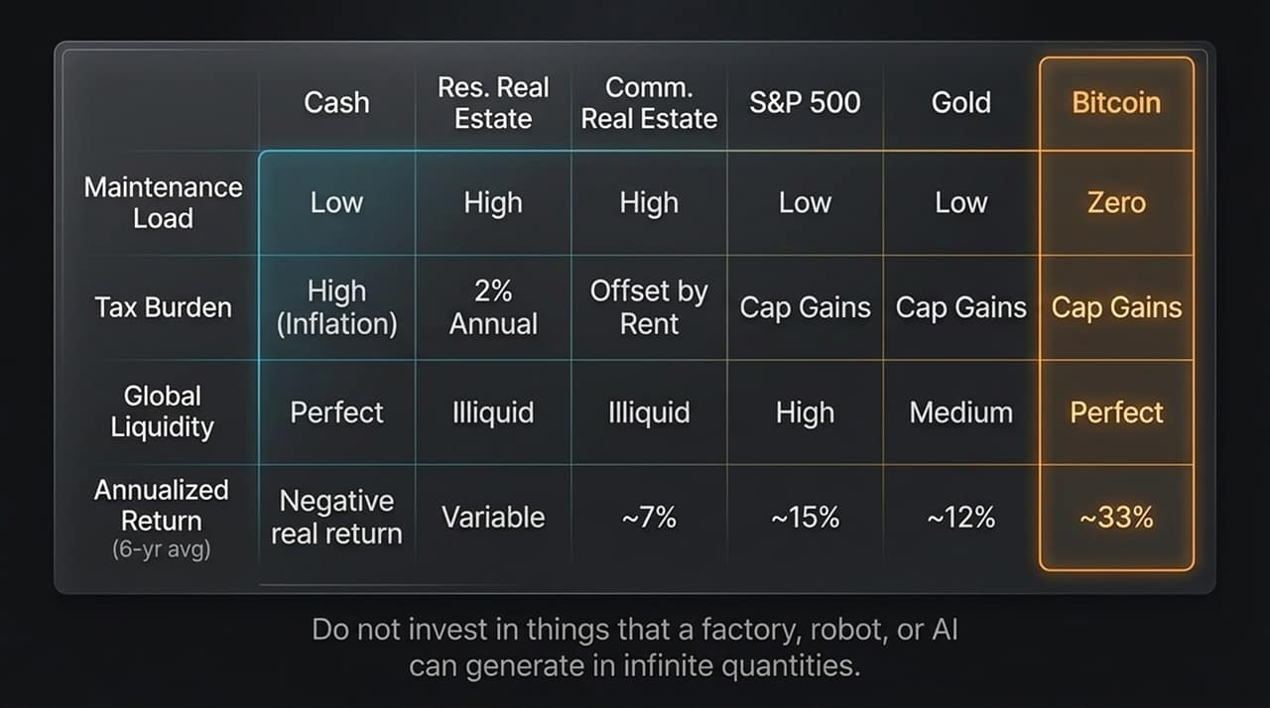
Notes:
To survive this loss of purchasing power, humanity has spent centuries moving capital into various asset classes. But when you evaluate them side-by-side, every traditional asset reveals fatal structural flaws:
Cash: Zero maintenance load, perfect global liquidity, but suffers a -7% annual real return due to systemic debasement.
Residential & Commercial Real Estate: Real estate gives you decent returns (around 7% to 12%), but it comes with high maintenance loads, high property taxes, and complete illiquidity. In fact, with a 2% property tax, you effectively re-buy your own home from the state every 36 years. Furthermore, real estate is tethered to a physical jurisdiction subject to municipal risk.
Stocks (S&P 500): Equities generate around 15% annualized, but they carry counterparty risk, CEO execution risk, competition, and corporate tax burdens.
Gold: Gold has low maintenance, but it is heavy, hard to transport, difficult to audit, and susceptible to supply expansion whenever the price rises.
Bitcoin: Bitcoin is the only asset with zero maintenance load, perfect global liquidity, capital gains tax efficiency, zero counterparty risk, and a 33% 6-year annualized yield.
The rule for the modern era is simple: Do not invest in things that a factory, a robot, or an AI can generate in infinite quantities.

Slide 4
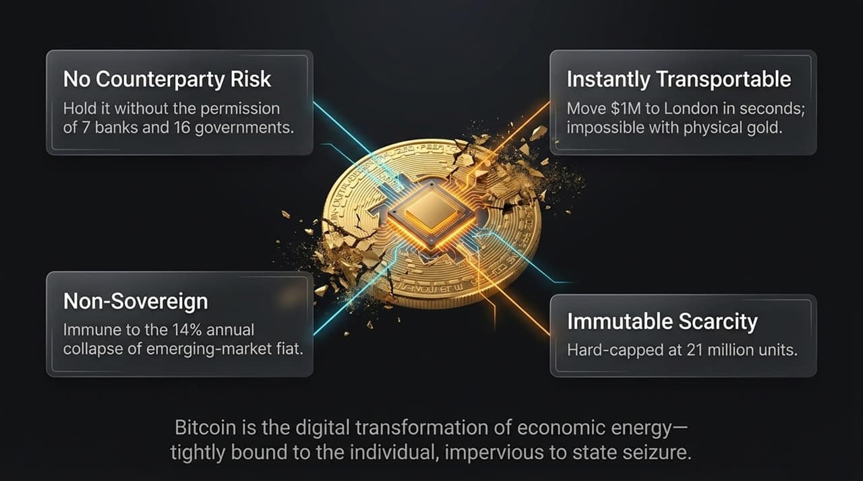
Notes:
What makes Bitcoin fundamentally superior to everything else on that table? It is the digital transformation of economic energy. It takes kinetic economic output and converts it into pure, encrypted, digital capital.
Let's look at its four defining pillars:
No Counterparty Risk: You can hold your economic energy without needing permission from 7 banks and 16 governments. It exists independently of the legacy financial system.
Instantly Transportable: Try moving $10 million in physical gold across a international border in ten minutes. It’s impossible. With Bitcoin, you can transport $100 million or $1 billion across the globe in seconds for a fraction of a dollar.
Non-Sovereign: It is immune to local currency meltdowns and the hyperinflationary spirals that routinely destroy emerging-market fiat.
Immutable Scarcity: Gold's supply increases whenever miners dig deeper. Real estate supply increases when developers build skyscraper condos. But Bitcoin is strictly hard-capped at 21 million units.
It is monetary policy written in code and enforced by thermodynamics—completely impervious to state seizure when properly secured.

Slide 5
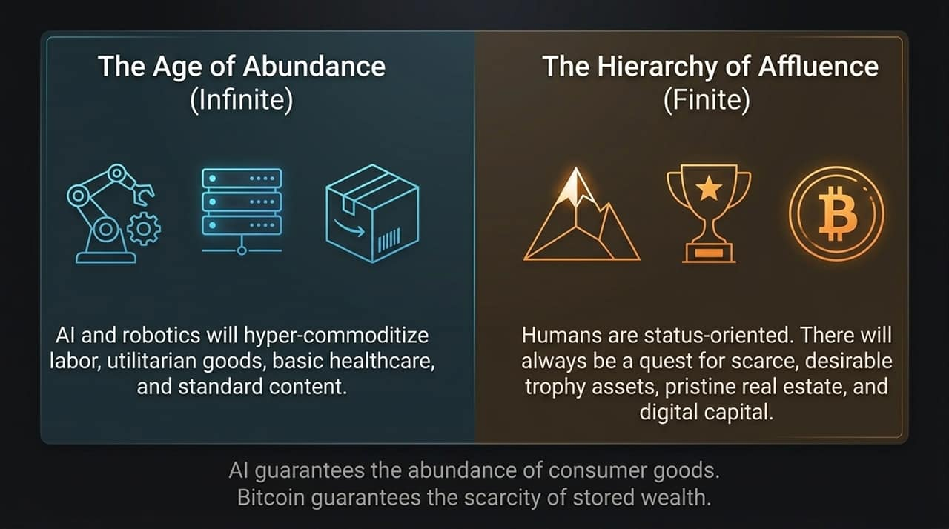
Notes:
Now, let’s bring Artificial Intelligence into the narrative. We are moving toward a world bifurcated into two realms: The Age of Abundance and The Hierarchy of Affluence.
AI and robotics will hyper-commoditize everything that can be reproduced: basic labor, utilitarian goods, software code, standard medical diagnostics, and digital content. The cost of producing a line of code or a custom video is trending toward zero. This creates an infinite supply of general goods and services.
However, human beings are fundamentally status-oriented, positional creatures. As basic survival goods become nearly free, human demand will concentrate entirely on finite, scarce, and non-replicable trophy assets: pristine real estate, unique historical artifacts, prestige experiences, and digital capital.
AI guarantees the abundance of consumer goods, while Bitcoin guarantees the absolute scarcity of stored wealth. If you want to build enduring wealth, you must store your value in the finite realm, not the abundant one.

Slide 6
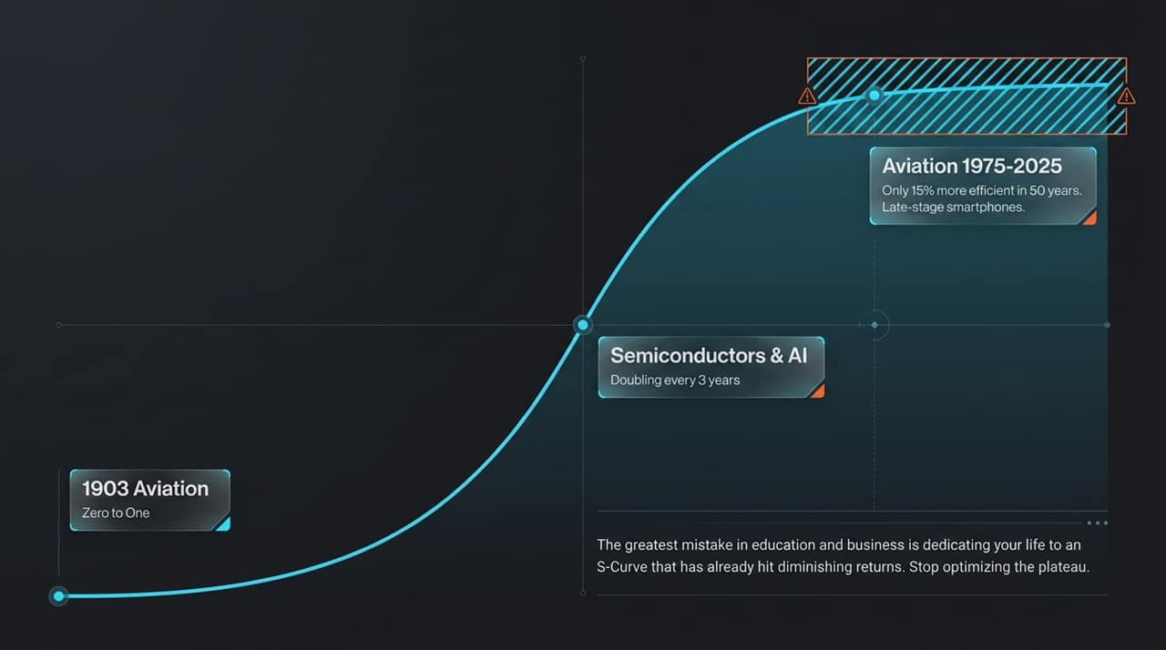
Notes:
Understanding structural shifts requires understanding how technological adoption moves along an S-Curve.
In 1903, aviation went from Zero to One. Between 1903 and 1970, aviation experienced exponential performance gains. But look at aviation from 1975 to today: aircraft are only about 15% more fuel-efficient over 50 years. The technology hit the plateau of diminishing returns. We see the exact same plateau today in late-stage smartphones and traditional computing hardware.
Where is the exponential growth today? It is in Semiconductors and AI, where capabilities are doubling rapidly.
The single greatest mistake you can make in education, career planning, or corporate management is dedicating your life or capital to an S-Curve that has already hit its plateau. Stop optimizing legacy industries that have flatlined. Align your efforts with technologies that are currently at the bottom of their vertical S-Curve velocity.

Slide 7
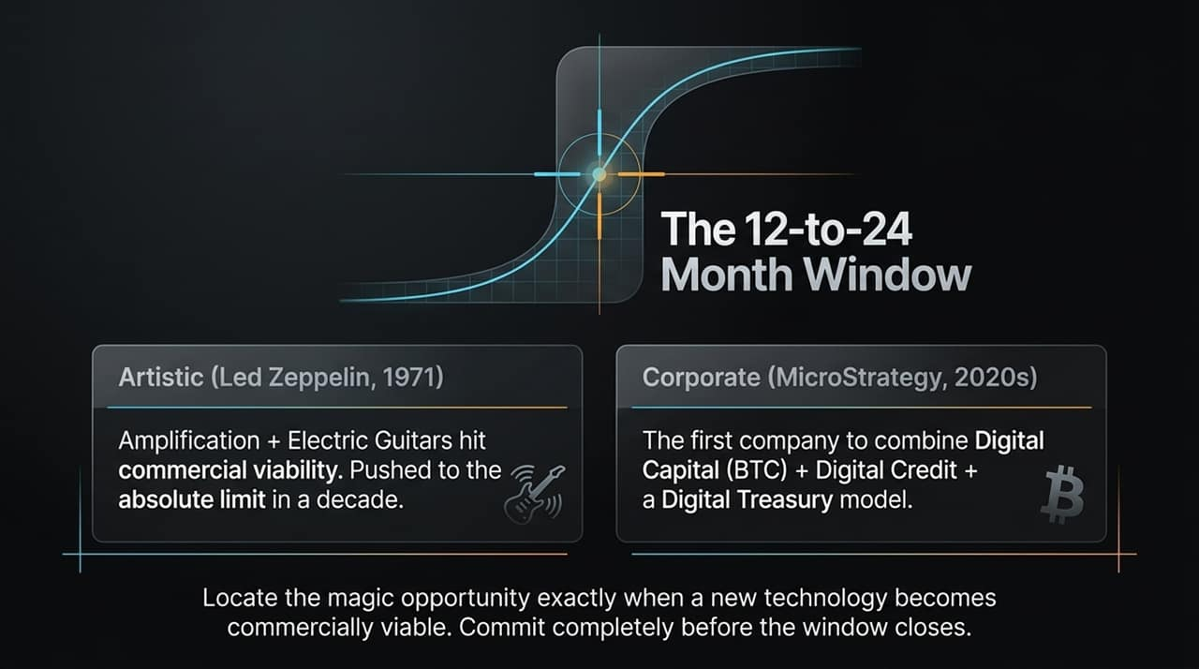
Notes:
When a revolutionary technology transitions from theoretical to commercially viable, a 12-to-24 month window opens where generational fortunes and industry dominance are decided.
Look at history:
Artistic Example: In 1971, Led Zeppelin combined electric amplification, recording tech, and distribution to redefine global rock music. They recognized the inflection point of electric music tech and pushed it to its absolute limits within a decade.
Corporate Example: In the 2020s, MicroStrategy became the first public enterprise to systematically combine Digital Capital (Bitcoin) with Digital Credit and equity markets to transform a software company into a high-performance Digital Treasury model.
The goal is to spot the exact moment a new technology moves from academic curiosity to commercial leverage, and then commit completely before the window closes and the mainstream consensus catches up.

Slide 8
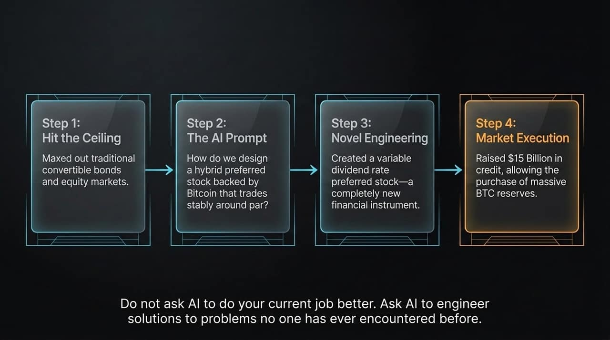
Notes:
Let's analyze how this mindset plays out in corporate strategy using MicroStrategy as a live blueprint:
Step 1 (Hit the Ceiling): Traditional capital markets presented flat yields, low growth, and standard corporate finance tools reached their logical limit.
Step 2 (The AI Prompt): Instead of asking standard questions, the question posed was radical: "How do we design a hybrid security backed by Bitcoin that trades stably around par while giving us access to low-cost capital?"
Step 3 (Novel Engineering): The team engineered novel financial products—like variable dividend rate preferred stock and customized convertible notes—creating entirely new instruments tied to digital capital.
Step 4 (Market Execution): By executing this design, billions in institutional capital were raised and converted directly into long-term Bitcoin reserves.
The lesson here goes beyond finance: Do not use AI or modern tools just to perform your existing job 5% faster. Use AI to engineer novel solutions to structural problems that no one in your industry has ever tackled.

Slide 9
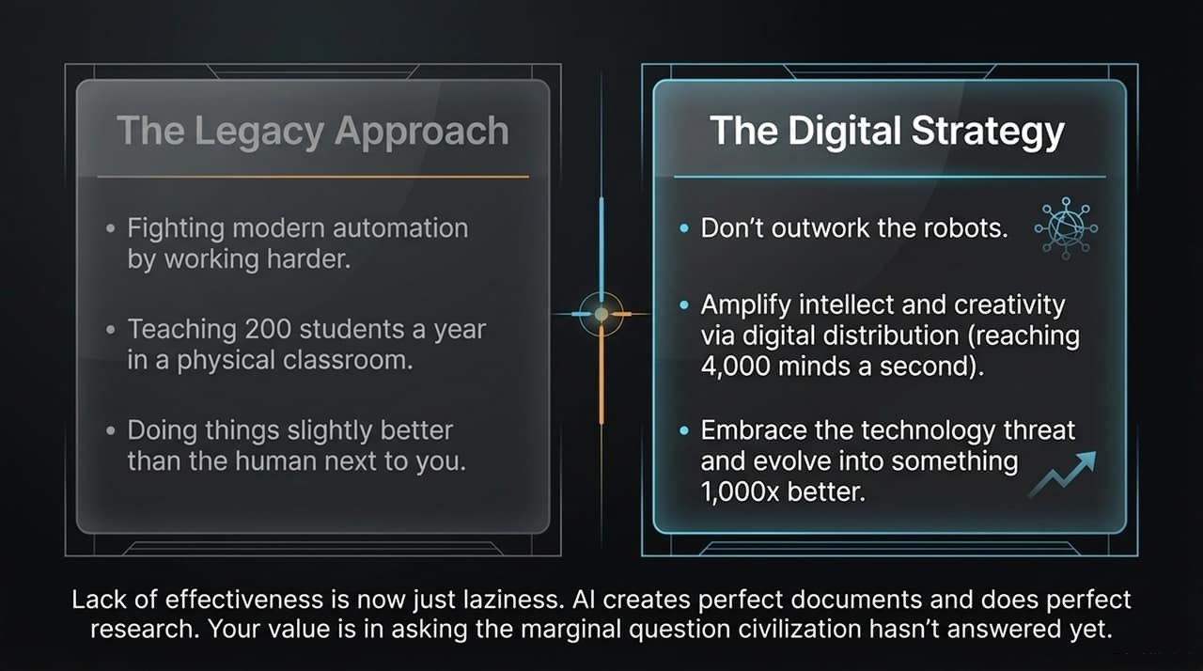
Notes:
To adapt to this environment, we must completely discard the Legacy Approach to productivity.
The legacy model tells you to work harder, fight automation, teach 200 students in a physical lecture hall, or try to be 5% better than the person sitting at the desk next to you. That strategy is obsolete. You cannot outwork an AI that operates 24 hours a day, 7 days a week, at zero incremental cost.
The Digital Strategy demands a fundamentally different posture:
Don't outwork the robots. Out-think them.
Amplify your intellect and creativity using digital distribution. Aim to broadcast your ideas to thousands of minds per second globally rather than locally.
Embrace technology as a leverage multiplier. Transform yourself into a hyper-efficient, 1,000x operator.
Lack of execution speed is no longer acceptable. AI can synthesize research, write boilerplate code, and organize information flawlessly. Your true value lies in asking the precise, critical questions that civilization has not yet solved.

Slide 10
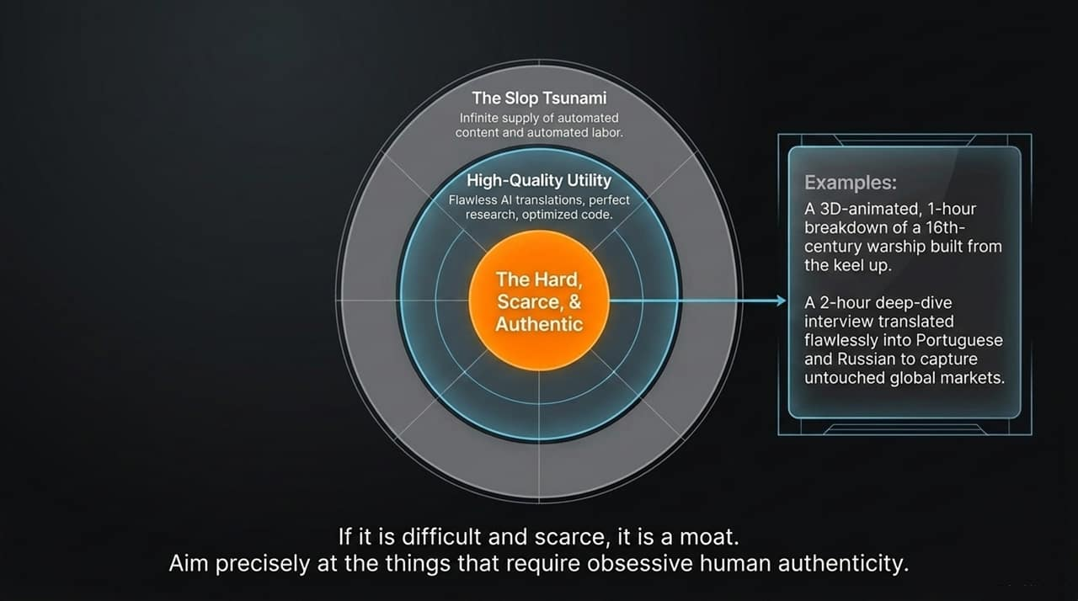
Notes:
As AI adoption accelerates, the market is being flooded by what can be called "The Slop Tsunami"—an infinite, low-cost supply of generic automated text, voice, and media.
If you produce average work, you will be drowned by this noise. To build an unassailable moat, you must move inward toward The Hard, Scarce, & Authentic core:
Outer Layer (The Slop Tsunami): Automated, low-value commodity content that AI generates effortlessly.
Middle Layer (High-Quality Utility): Useful tools like flawless translation, speed-optimized code, and rapid data extraction.
Inner Core (Hard, Scarce, & Authentic): Deep, highly specialized work that requires extraordinary human intent, domain expertise, and painstaking effort.
For example, producing a meticulously researched, 3D-animated historical analysis or conducting a deeply nuanced 2-hour interview translated perfectly across languages to capture underserved global audiences. If it is difficult and scarce, it is a moat. Focus your energy on things that require obsessive human authenticity.

Slide 11
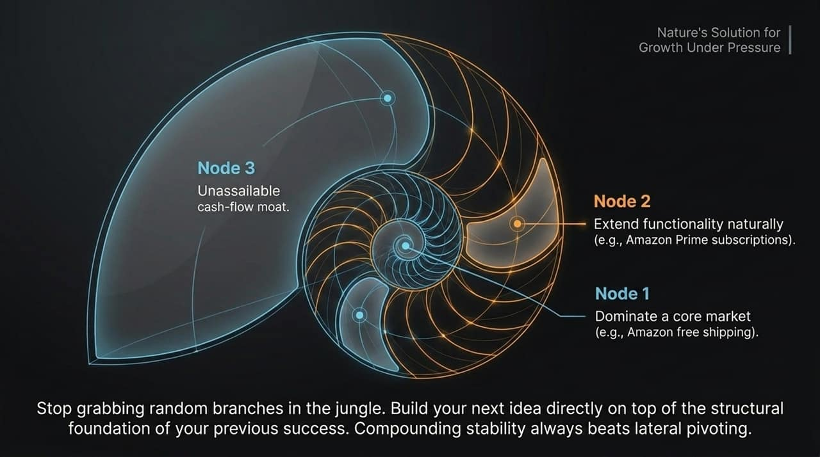
Notes:
When expanding an enterprise or career, avoid the trap of constantly pivoting laterally into random fields. Look at nature: the nautilus shell expands organically by extending outwards while preserving its core structure.
This spiral strategy represents compounding stability:
Node 1: Focus until you dominate a single core capability or market (e.g., Amazon establishing its distribution moat with free shipping).
Node 2: Extend functionality naturally directly from that core (e.g., Amazon introducing Prime subscriptions on top of that existing logistics engine).
Node 3: Build an unassailable cash-flow moat where each layer reinforces the structural stability of the entire ecosystem.
Stop chasing unrelated trends. Build your next innovation directly on top of the concrete foundation of your past success.

Slide 12
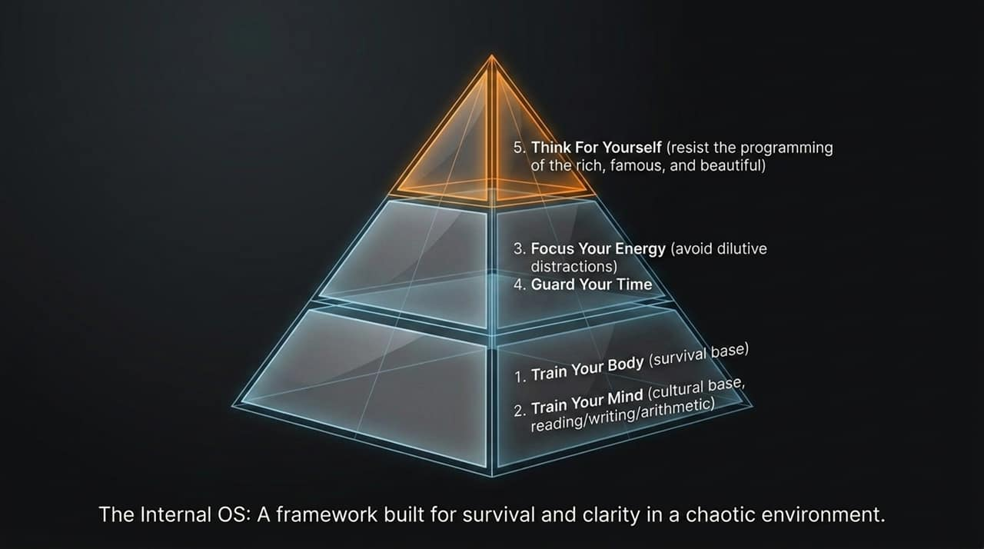
Notes:
To execute at a high level without breaking under pressure, you need an Internal Operating System built for resilience:
Level 1: Train Your Body (Survival Base): Physical health is your foundational asset. Without energy, stamina, and physical vigor, intellectual capacity quickly degrades.
Level 2: Train Your Mind (Cultural Base): Master fundamental skills—reading, writing, and logic. Clear thinking stems directly from clear expression.
Level 3 & 4: Focus Your Energy & Guard Your Time: Eliminate low-value distractions. Time is your non-renewable resource; treat every hour with deliberate discipline.
Level 5: Think For Yourself (Sovereignty): Resist the mental programming of social media, institutional narratives, and popular consensus.
In a world full of algorithmic noise, independent thinking is the ultimate competitive advantage.

Slide 13
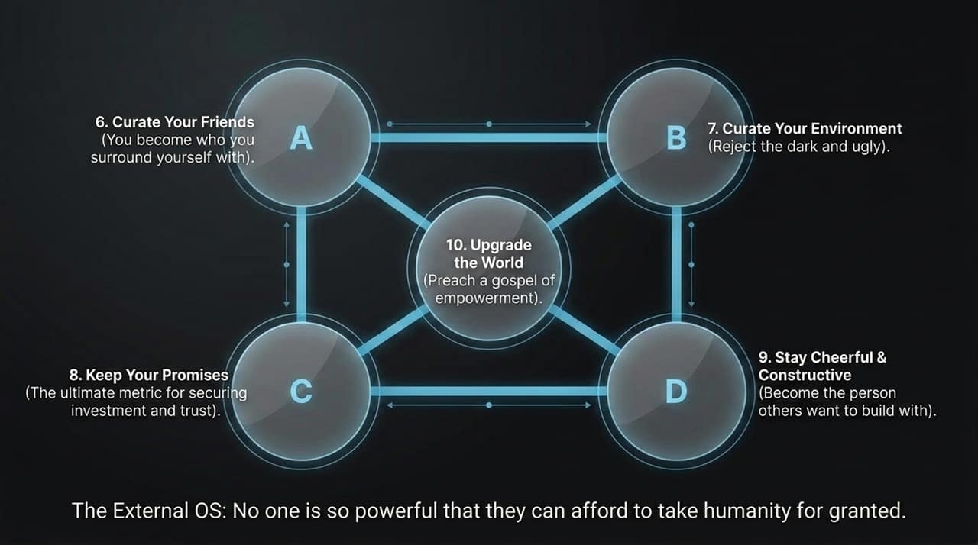
Notes:
Your internal mindset must be complemented by an External Operating System for interacting with society:
Node A (Curate Your Friends): You are the average of the people you spending time with. Surround yourself with high-agency, principled builders.
Node B (Curate Your Environment): Intentionally eliminate toxic, degrading inputs from your daily surroundings.
Node C (Keep Your Promises): Trust is the ultimate currency. Reliability is the primary metric institutional partners and investors look for when allocating capital.
Node D (Stay Cheerful & Constructive): Pessimists sound smart, but optimists build the future. Be the energetic, solution-oriented partner others want to build with.
Center Node (Upgrade the World): Channel your personal agency into uplifting your community and building lasting value.

Slide 14
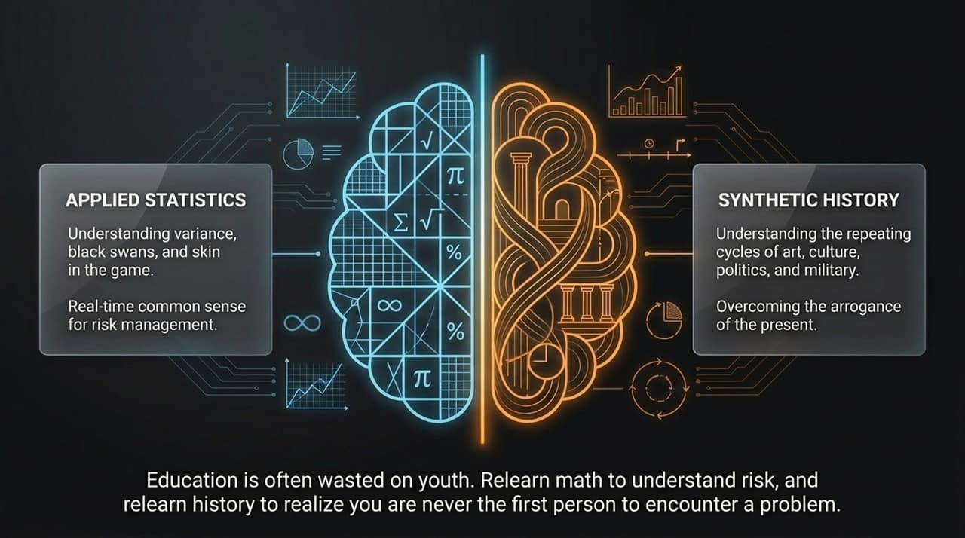
Notes:
Standard formal education is often wasted on youth because it focuses on rote memorization rather than actionable decision-making frameworks. To navigate the digital frontier, we must revisit two critical subjects:
Applied Statistics: You must master the math of probability, variance, black swan events, and skin-in-the-game. Statistical literacy provides real-time risk management for your capital and career.
Synthetic History: Study the recurring cycles of civilizations, economies, and monetary collapses. History frees you from the arrogance of the present, showing that human nature remains constant across technological shifts.
When you understand statistics, you can accurately price risk. When you understand history, you realize that every modern crisis has a historical precedent you can learn from.

Slide 15
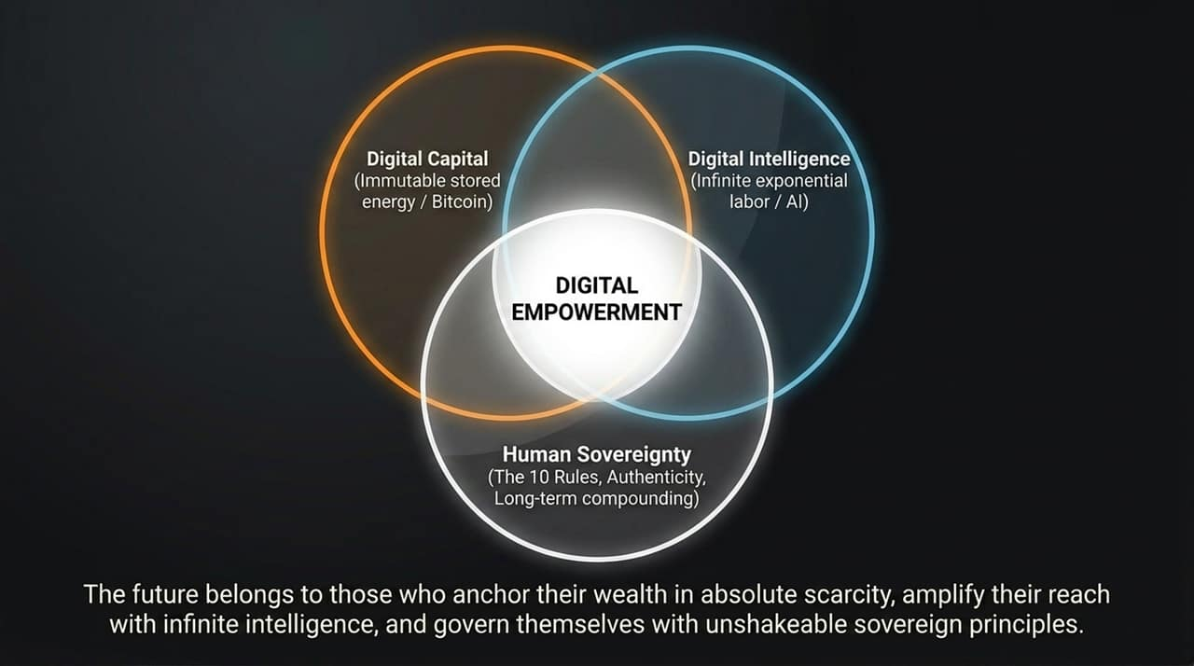
Notes:
This brings us to the core synthesis of our framework: The Digital Empowerment Model.
True modern power relies on balancing three distinct vertices:
Digital Capital: Anchored by immutable, scarce monetary energy (Bitcoin) to store your wealth across time and space without counterparty risk.
Digital Intelligence: Driven by artificial intelligence to give you exponential leverage over production, research, and technical execution.
Human Sovereignty: Governed by an unshakeable internal OS, deep authenticity, personal integrity, and long-term discipline.
If you lack digital capital, your wealth decays. If you lack digital intelligence, your productivity gets outpaced. If you lack human sovereignty, you lose direction. Master all three to secure complete autonomy.

Slide 16
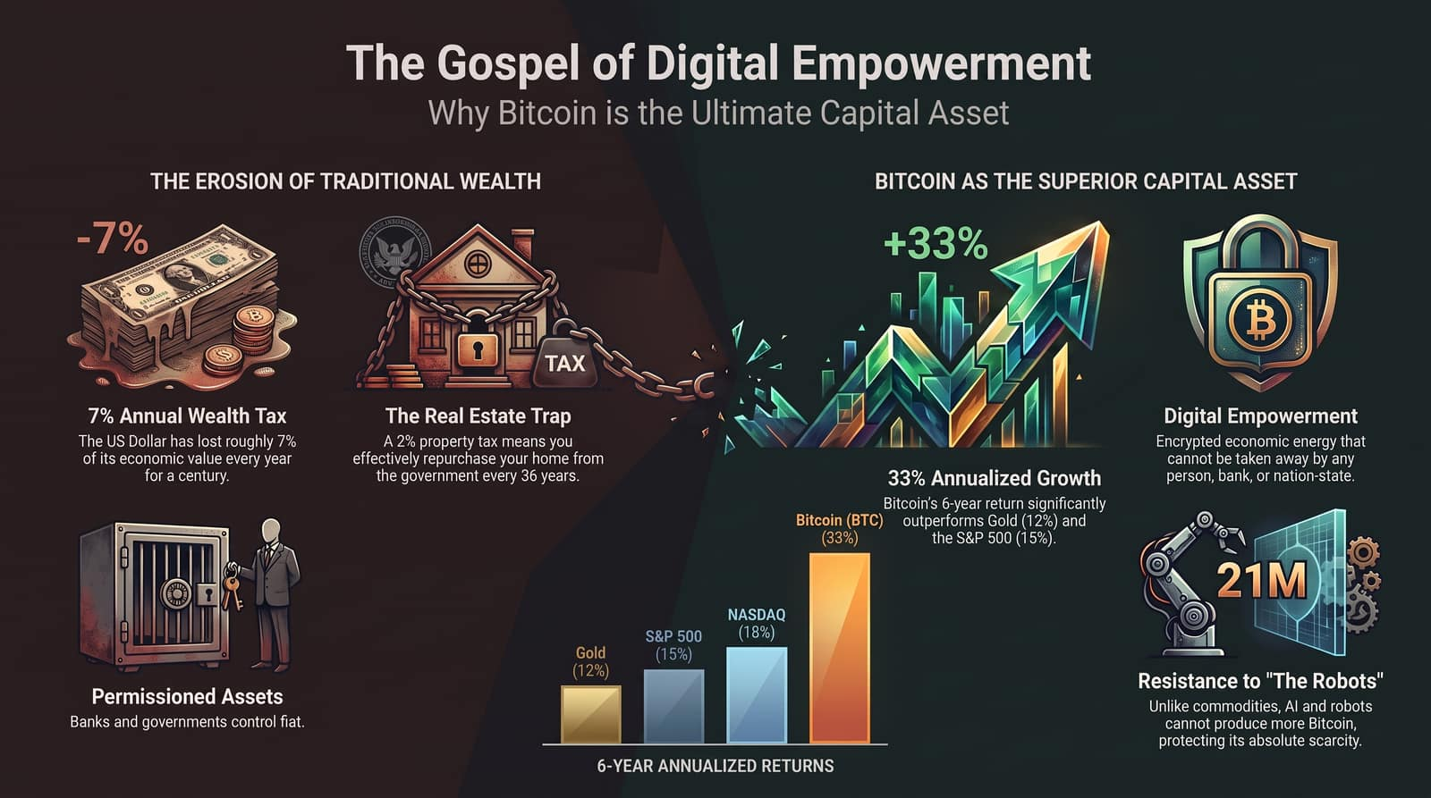
Notes:
To close, let's look at the stark contrast between the traditional trap and the digital alternative:
The Erosion of Traditional Wealth: Cash loses 7% of its value every year. Real estate traps you with 2% annual property taxes and regulatory drag. Traditional fiat assets leave your wealth exposed to institutional control.
The Superiority of Digital Capital: Over a 6-year average, Bitcoin has delivered 33% annualized returns, significantly outperforming Gold (12%), the S&P 500 (15%), and the NASDAQ (18%).
Absolute Scarcity: While AI and automation produce an infinite supply of goods and services, Bitcoin’s 21 million supply cap ensures its long-term purchasing power remains secure.
The takeaway is clear: Anchor your stored energy in absolute digital scarcity, scale your output using artificial intelligence, and live by unshakeable principles of human sovereignty.

